Slide 1
BLMK Learning Disabilities and Autism Strategy 2023/2026 (FINAL)
October 2023 v.7

Slide 2
Contents summary
What is a Quality Improvement Approach?
Step 1, Choose a population segment
Step 2, Identify needs and assets
Step 3, Create a governance structure
Step 4, Develop a purpose & change theory
Our Strategy: 5 Asks
Our Strategy: What we are Going to Do
Step 5, Develop a measurement plan
Measurement Plan
Appendix: Language

Slide 3
A Quality Improvement (QI) approach was used to develop the Learning Disabilities and Autism Inequalities Strategy
The BLMK Learning Disabilities and Autism (LDA) Equalities steering group met for the first time on 5th January 2023, and we agreed to work on a system-wide LDA Equalities strategy.
The steering group included partners working with people with learning disabilities and autistic people across the BLMK Integrated Care System (ICS).
The group has adopted a QI approach, using the below sequence to develop the strategy
1. Choose a population segment
2. Identify Assets and Needs
3. Create a Governance Structure
4. Develop a purpose and change theory
5. Develop a measurement plan
6. Start testing changes
Adapted from the IHI’s Triple Aim Framework

Slide 4
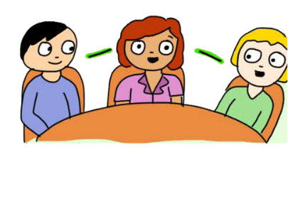

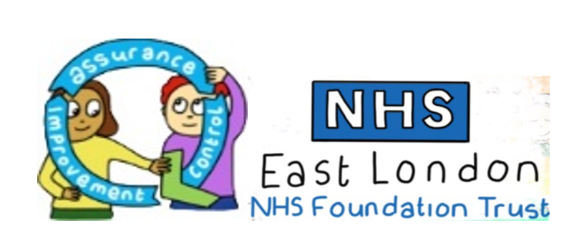
What is Quality Improvement (QI)?
“Quality improvement (QI) is about giving the people closest to issues affecting care quality the time, permission, skills and resources they need to solve them.
It involves a systematic and coordinated approach to solving a problem using specific methods and tools with the aim of bringing about a measurable improvement.”
(Health Foundation, 2021)
People closest to the issue
Permission
Skills
Resources
Not jumping straight to solutions!

Slide 5
Step 1 – Choose a population segment
Things to consider when choosing a population:
Is there a segment of the population that is failing to thrive, where there might be some apparent inequity?
Is the population segment an achievable size to target effective testing?
Is existing work taking place and is this work a priority to those in the system?
Are there other partners who share responsibility for this population that are willing to partner with us in this work?
Is there readily available data that people are willing to share?
1. Choose a population segment
2. Identify Assets and Needs
3. Create a Governance Structure
4. Develop a purpose and change theory
5. Develop a measurement plan
6. Start testing changes

Slide 6
Detailed Overview of the QI Sequence Used
1. Choose a population segment
2. Identify Assets and Needs
3. Create a Governance Structure
4. Develop a purpose and change theory
5. Develop a measurement plan
6. Start testing changes
Who are the people we are most worried about?
Which segment(s) of the population are experiencing poorer access, experience, or outcomes?
What does this population segment need?
Do we understand what opportunities there are?
See: 3-part data review
Who do we need to involve in this work?
How will that involvement be structured?
See: stakeholder mapping
What is the purpose of this work?
What is our theory about how we will improve things?
See: driver diagrams
How will we measure improvement?
What are our outcome, process and balancing measures?
What is our data collection plan?
What ideas have we generated through this process that we can test?
See: PDSA cycles
Adapted from the IHI’s Triple Aim Framework

Slide 7
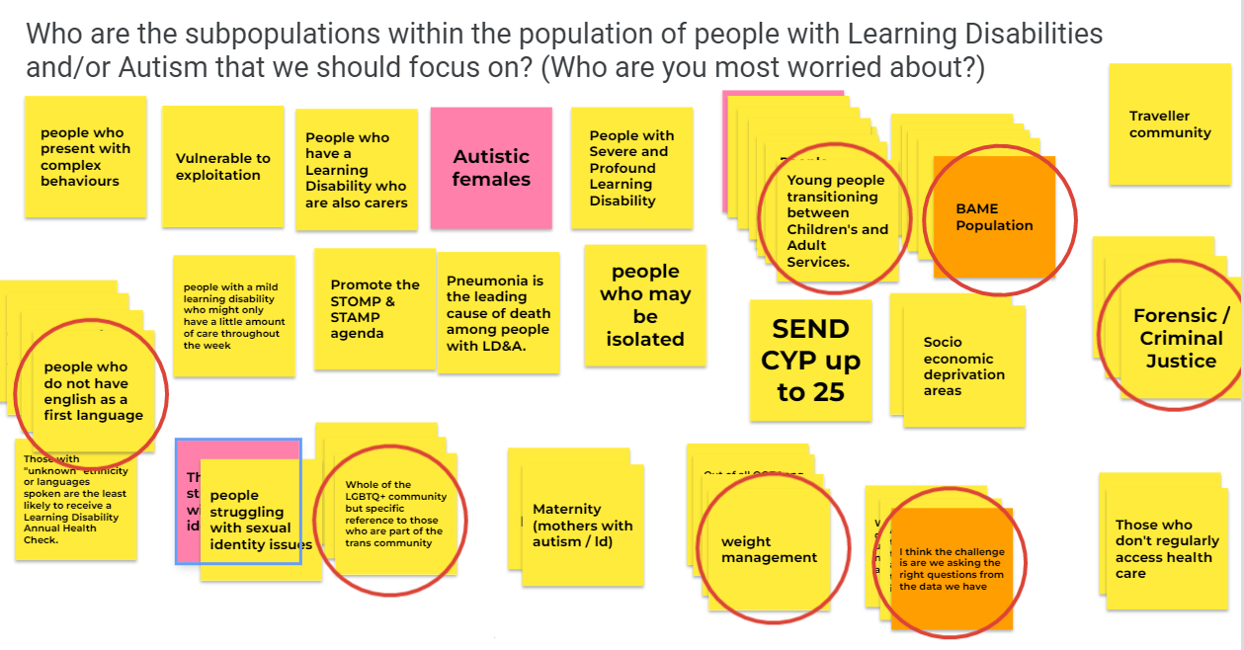
Step 1 – Choose a population segment
Our population segment is adults with Learning Disabilities and Autistic people in Bedfordshire, Luton and Milton Keynes (BLMK). As well as health challenges faced by this group, there is also an unequal spread of health within the population.
We thought about which groups within this population that need extra focus (the groups we were most worried about.)

Slide 8



Step 1 – Choose a population segment
The groups of people with Learning Disabilities and Autistic people we felt needed extra focus were:
People who don’t speak English as a first language
LGBTQ+ community
Young people transitioning to adult services
Ethnic minority groups
Forensic/criminal justice population
People requiring weight management
People experiencing comorbid mental illness or complex behaviours
Males with a learning disability are less likely to have an annual health check than females.
People with learning disabilities of Black ethnicity are less likely to receive an Annual Health Check compared to the rest of the population.

Slide 9
Step 2 – Identify Needs and Assets
The work should derive from meeting the needs and maximising the assets of the population we serve.
Needs are typically defined as problems or barriers experienced by the population that require an intervention.
Assets are the collective resources that people and communities have at their disposal, which can help promote health and wellbeing. These can include:
Individual – personal resilience, individual talents
Community – Community groups, social clubs, resident’s associations
Organisational – Faith groups, coffee shops, community hubs, health and social care services
1. Choose a population segment
2. Identify Assets and Needs
3. Create a Governance Structure
4. Develop a purpose and change theory
5. Develop a measurement plan
6. Start testing changes

Slide 10
Step 2 – Identify Needs and Assets
2. Identify Assets and Needs
To identify the needs and assets of people with a learning disability and autistic people in BLMK, we undertook a 3-part data review. This meant following 3 steps:
Review the data already available – quantitative and qualitative
Seek input from those working with, and supporting, this population
Learn from people with lived experience
What does the data say?
What do people who work closely with the population say?
What do people with lived experience say?

Slide 11
Step 2 – Identify Needs and Assets
The number of people recorded on the BLMK learning disability register increased by almost 6% between March 2022 and March 2023.
The proportion of people with a learning disability in BLMK with a comorbidity increased from 2022 to 2023. The largest comorbidity increases were observed within Non-Diabetic Hyperglycaemia, Obesity, Hypertension, Depression, Diabetes, and Asthma.
People with a learning disability in BLMK were found to be 24% less likely to receive Bowel Cancer Screening, 15% less likely to receive Breast Cancer Screening, and 3% less likely to receive Cervical Cancer Screening compared to the population average.
Autistic people in BLMK were found to be 16% less likely to receive Bowel Cancer screening, 10% less likely to receive Breast Cancer Screening, and 7% less likely to receive Cervical Cancer Screening compared to the population average.
Males are less likely to receive a learning disability Annual Health Checks than females.
People with an ‘unknown’ severity of learning disability are 4% less likely to receive an Annual Health Check compared to the rest of the population.
People with an ‘unknown’ ethnicity are almost 8% less likely to receive an Annual Health Check compared to the rest of the population.
2. Identify Assets and Needs
What does the data say?

Slide 12
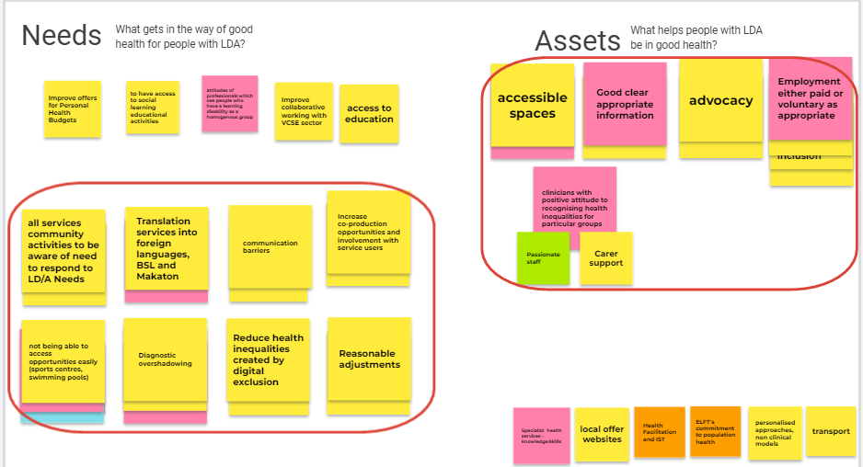
Step 2 – Identify Assets and Needs
We thought about the key needs and assets of people with a Learning Disability and/or Autism in the LDA Equalities steering group. The key themes are in the red boxes.
2. Identify Assets and Needs
2. What do people who work closely with the population say?

Slide 13

Engagement Sessions
We held three focus groups with people with Learning Disabilities, Autistic people, and their carers and families: one in Bedford, one in Luton, and the third in Milton Keynes.
These are in addition to the extensive engagement work done as part of the Denny review, which along with the work of the collaborative, will support development of the strategy further to Place level.
2. Identify Assets and Needs
3. What do people with lived experience say?

Slide 14

Access to Primary Care
“I go to the Walnut Surgery and need to go twice a month. I struggle with the automated phone system. There are too many options. I forget which one I need. It’s a struggle to get an appointment.”
BLMK LD registered patients with a QoF comorbidity was 58.9% in 2021/22; in 2022/23 the figure is 61.3%, reflecting more complex health care needs in people with a learning disability.
6.59% of the BLMK LD Register aged 14+ did NOT receive a LD Annual Health Check between April 2021 – March 2023
    Access to primary care was one of the most commonly mentioned challenges for people with learning disabilities and autistic people in BLMK.
Phones were not an option for a lot of people, a barrier to accessing care (particularly primary) especially if no carer/support to use phone for them
(H) “I struggle on the phone. My mum makes my appointments for me. I want to do it myself, but I find the phone system frustrating”.
(J) “ When you get a call back from the Doctor’s, they come from withheld numbers. I don’t answer those calls.”
Being unable to access primary care leads to people attending A&E, which is a stressful environment for people with learning disabilities and autistic people
“There is nowhere to go except A&E if my need is not urgent, but I can’t get a GP appointment, for example for my diabetes or for antibiotics.”
Notes:
Reference: A PHE report looking at oral health inequalities says approximately one in three adults with learning disabilities have unhealthy teeth and gums (2019), and surveys also show patients with learning disabilities have higher rates of untreated decay, a greater number of extractions and a higher prevalence of complete tooth loss, than the general population.
From <https://bda.org/about-the-bda/campaigns/oralhealth/Pages/learning-disabilities.aspx>
We know that children and young people with a learning disability, autism or both have higher levels of untreated tooth decay. A healthy mouth is important for overall health and wellbeing. Good oral hygiene can affect your child’s ability to eat, sleep, talk, and play. It’s also important for how they feel about themselves. Tooth decay and gum disease are the most common UK dental problems, but are mostly preventable.
https://www.england.nhs.uk/learning-disabilities/improving-health/eye-care-dental-care-and-hearing-checks/dental-care/

Slide 15
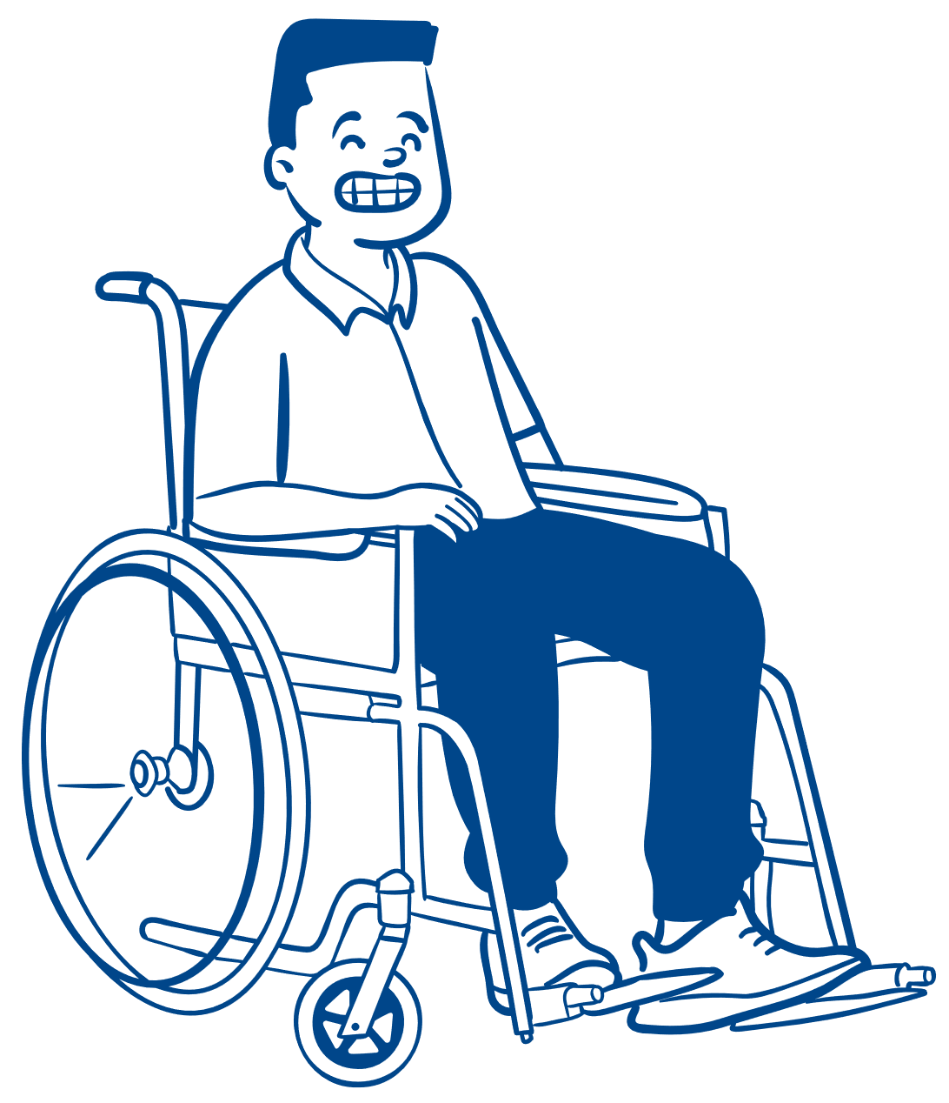


Oral Health: the impact of reasonable adjustments
“Going to the dentist is (quite the) experience for an autistic person when you consider the sensory sensitivities of being tilted backwards in the chair, the taste of the mouthwash, the tools used, the noises from the tools, the lighting from the lamps that shine in your face and also people being in your personal space.”
One in three adults with learning disabilities have unhealthy teeth and gums
Children and young people with a learning disability, autism or both have higher levels of untreated tooth decay.
We heard lots of positive experiences of dentists making reasonable adjustments:
(H) “My dentist is in Woughton. It’s private. It’s very friendly. The staff know me. Mum comes with me for re-assurance, to make sure I understand what’s being said.”
(J) “My dentist is at Eaglestone which is part of the hospital at Milton Keynes. The staff always have a chat with me. They let me bring in a CD of relaxing music which is what I need.
“[The Luton Dental Centre has] good communication, procedures explained in a way I understand, they were open even during Covid, and are very good at helping with my anxiety.”
Negative experiences were mentioned less frequently, but they made a lasting impact:
“Due to previous experiences of the dentist. I haven’t been since I was fifteen [now early thirties] I would go to the dentist if it was absolutely necessary, but I’d have to be in pain to actually go.”
Notes:
Reference: A PHE report looking at oral health inequalities says approximately one in three adults with learning disabilities have unhealthy teeth and gums (2019), and surveys also show patients with learning disabilities have higher rates of untreated decay, a greater number of extractions and a higher prevalence of complete tooth loss, than the general population.
From <https://bda.org/about-the-bda/campaigns/oralhealth/Pages/learning-disabilities.aspx>
We know that children and young people with a learning disability, autism or both have higher levels of untreated tooth decay. A healthy mouth is important for overall health and wellbeing. Good oral hygiene can affect your child’s ability to eat, sleep, talk, and play. It’s also important for how they feel about themselves. Tooth decay and gum disease are the most common UK dental problems, but are mostly preventable.
https://www.england.nhs.uk/learning-disabilities/improving-health/eye-care-dental-care-and-hearing-checks/dental-care/

Slide 16





Broken Trust
“It’s very off putting and makes me not want to go back.”
Autistic people were over seven times more likely to report that their senses frequently overwhelm them so that they have trouble focusing on conversations with healthcare professionals.
In addition, they were over three times more likely to say they frequently leave their healthcare professional’s office feeling as though they did not receive any help at all
We consistently heard about the lasting impact of impressions that have been made in healthcare settings.
Broken trust builds anxiety and ultimately leads to avoidance:
“Some reception staff have been rude. It’s very off putting and makes me not want to go back. You feel like you’re wasting people’s time. You can end up feeling pretty worthless.”
One person’s journey to being referred for an autism diagnosis took a long time, several years. GP initially refused to refer him; was constantly ‘shot down’. This led to depression and now he ‘won’t go to GP unless absolutely necessary’. He has not been to a GP since 2019.
Someone recalled her experience of being asked to participate in groups with the previous Milton Keynes CCG in 2015, where she felt her time and contribution had not been valued: ‘treated as if I hadn’t got a brain’. This made her cautious of participating in future engagement activities.
Notes:
(Weir, E, Allison, C, & Baron-Cohen, S, 2022).

Slide 17



Addressing fear of the unknown
(J) “I went to a breast cancer screening and took my support worker with me. I was nervous. I didn’t know what to expect. In the lead up to the appointment my mind was full of ‘what if’ scenarios. It was scary. It’s the ‘unknown’s’ you worry about.”
People with a learning disability in BLMK were found to be 24% less likely to receive Bowel Cancer Screening and autistic people 16% when compared to the population average.
When we asked people if they would attend a screening appointment, most people said they would not attend. Fear of the unknown caused a lot of anxieties:
It’s ‘Scary, I won’t know what to expect.’
‘Panic… thinking “What if ...?’’
‘Really concerned about the results.’
‘Crowds’
‘How long will I be there for?’
People were very positive about ideas presented on familiarisation, such as open days, videos and easy-read information:
“Having videos sent out after sessions would be good because everyone learns in different ways. Autistic people process information in their own time. Videos would be helpful to assist in processing information and to refer back to if needed.”
“An open day would be very helpful.”
Notes:
Reference: A PHE report looking at oral health inequalities says approximately one in three adults with learning disabilities have unhealthy teeth and gums (2019), and surveys also show patients with learning disabilities have higher rates of untreated decay, a greater number of extractions and a higher prevalence of complete tooth loss, than the general population.
From <https://bda.org/about-the-bda/campaigns/oralhealth/Pages/learning-disabilities.aspx>
We know that children and young people with a learning disability, autism or both have higher levels of untreated tooth decay. A healthy mouth is important for overall health and wellbeing. Good oral hygiene can affect your child’s ability to eat, sleep, talk, and play. It’s also important for how they feel about themselves. Tooth decay and gum disease are the most common UK dental problems, but are mostly preventable.
https://www.england.nhs.uk/learning-disabilities/improving-health/eye-care-dental-care-and-hearing-checks/dental-care/

Slide 18
Why is it important to you to be healthy?
When asked this question, everyone told us their health was important to them.
People told us that not being well stopped them doing things they enjoyed, which led to mental health being negatively impacted.
(H) Mental and physical health matters to me. If I feel healthy, I feel positive. I feel happy. If I wasn’t healthy, I wouldn’t be able to do what’s important which is to go to my social groups and my employability group. Without these groups I’d feel emotional, bored, and lonely.
(K) I used to enjoy kickboxing, but I can’t do it now due to various physical health situations. I think it’s harder for autistic people to integrate with society if they are unhealthy and this leads to depression.
(M) I think my mental health is more important than my physical health. I need that time for ‘me’ during the day. If I don’t get it, I get depressed. I wouldn’t get out of bed if I knew I wouldn’t get any ‘me’ time on a particular day.
(J) My physical health is very important to me. If I am unwell, my daily routines are taken away from me. I feel depressed when this happens. My mental health takes a downturn if I’m stuck in bed. I need to be around people. Daily routines are extremely important for autistic people.
Research shows that autistic people are significantly more likely to experience a mental health diagnosis than those without
Notes:
(Joshi et al, 2013).

Slide 19
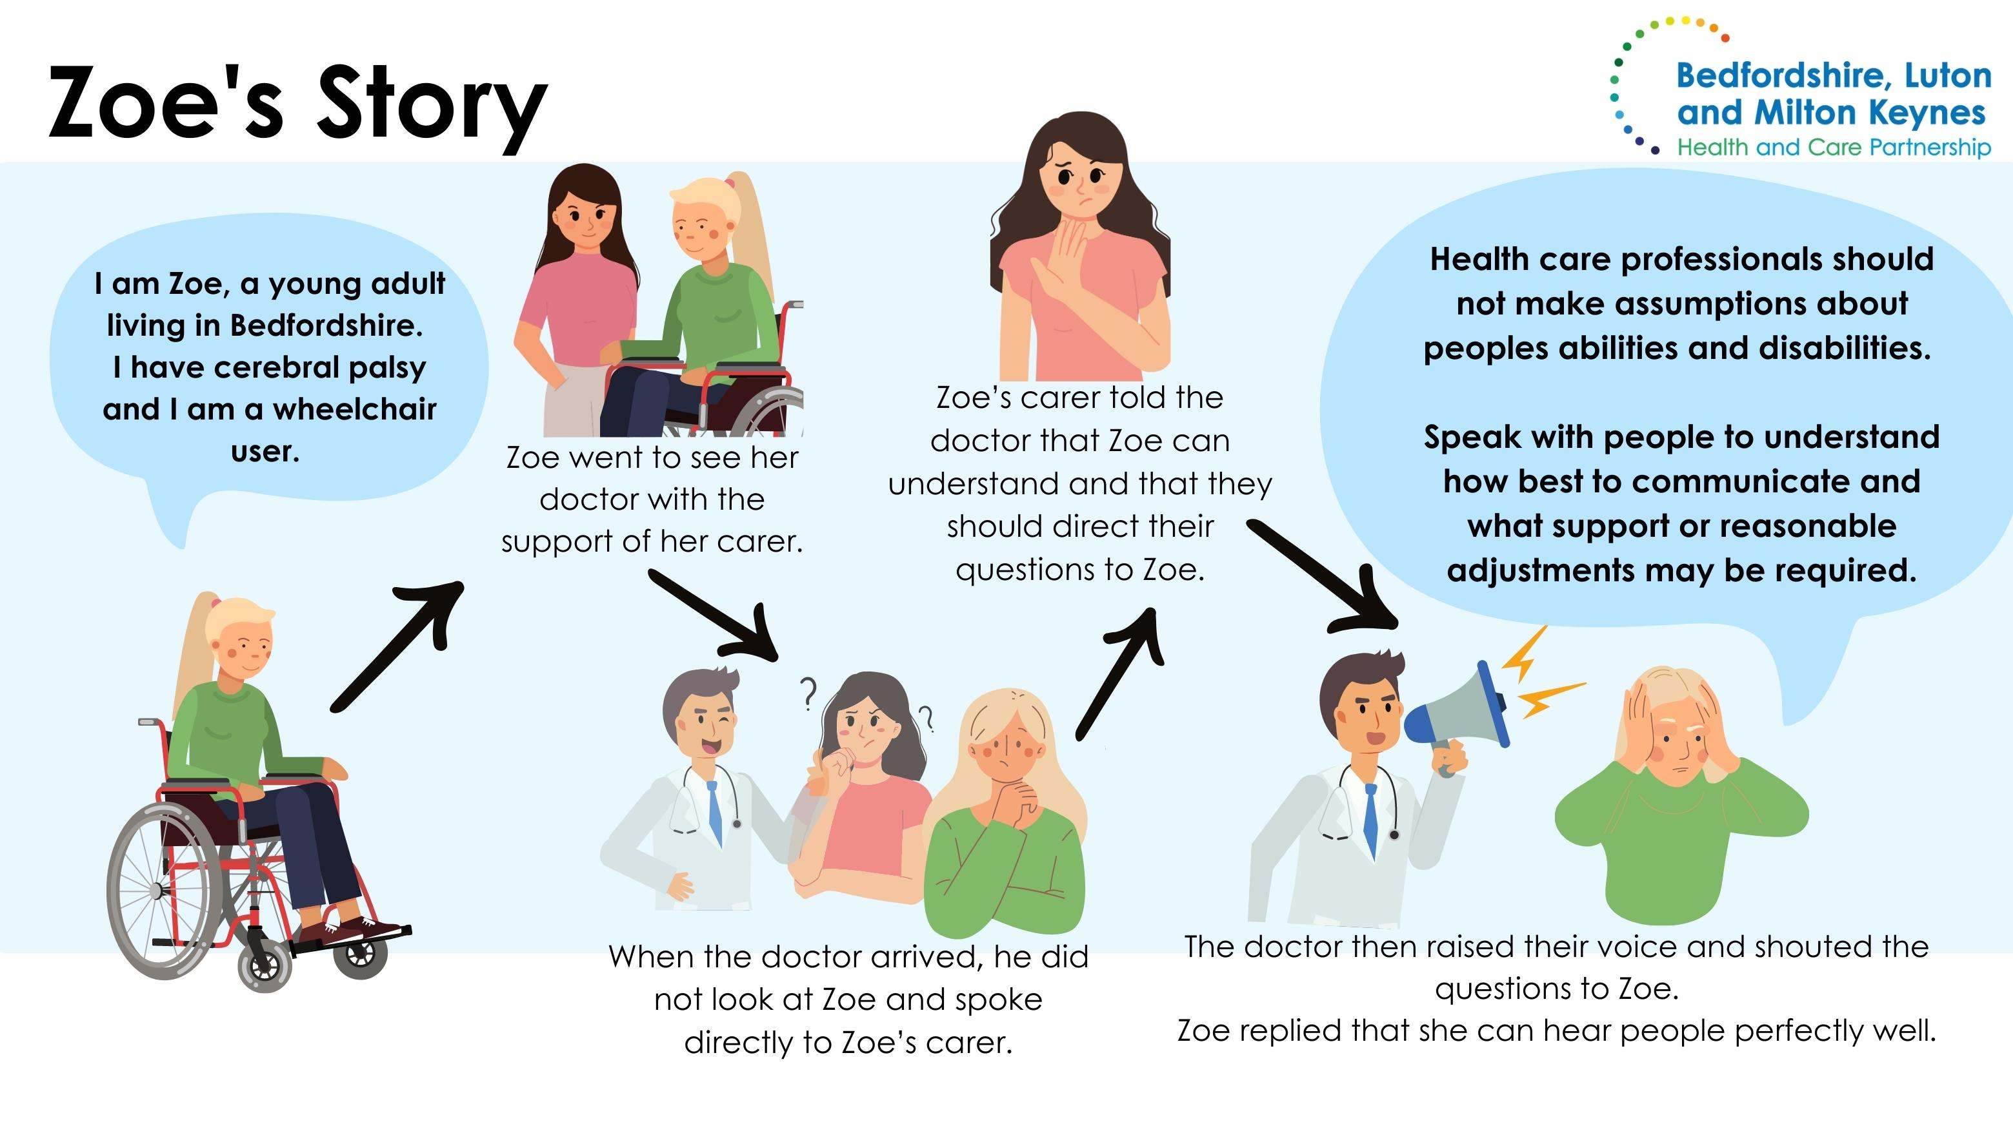

Slide 20
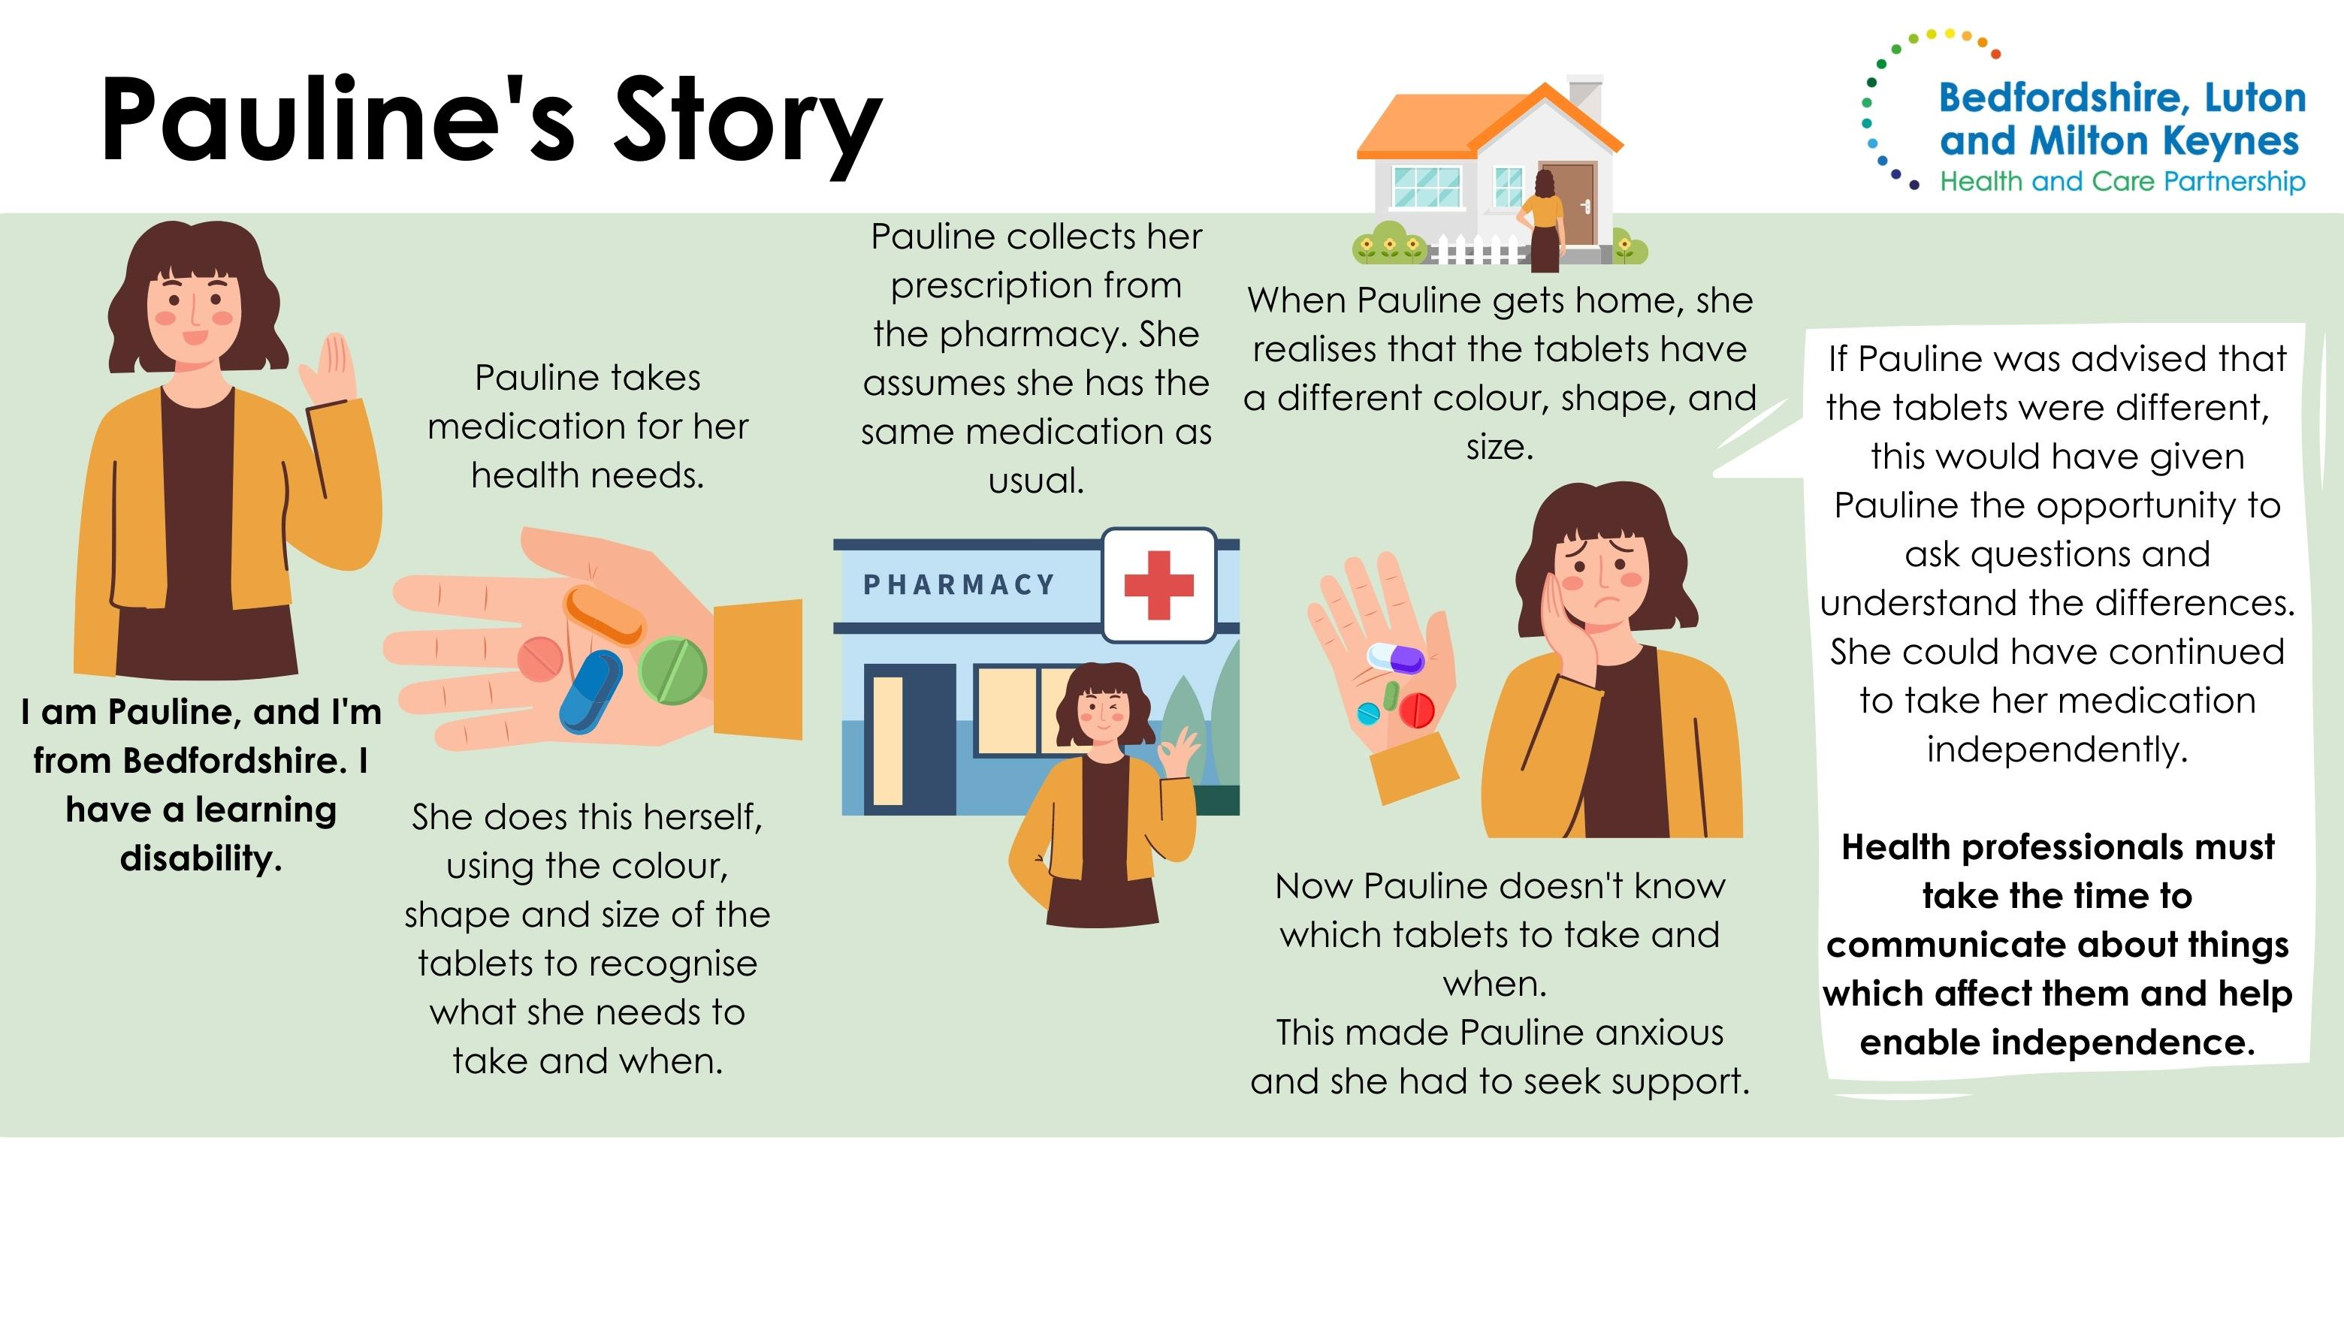

Slide 21
Key Takeaways
We were consistently told that people experienced low levels of access to primary care, which is leading people either to not access care or to use emergency routes (a stressful sensory experience)
There are longstanding issues with trust due to previous negative experiences accessing healthcare
'Fear of the unknown' is a big contributor to anxieties about attending health appointments, for example cancer screening
There are a small number of champion dentists which people reported positive experiences with, while a smaller number of people have negative experiences of dentists which stops them going regularly
People really cared about their health, and being in poor health stopped them doing the things that made them happy

Slide 22
Step 3 – Create a Governance Structure
Who do we need to involve in this work?
How will that involvement be structured?
1. Choose a population segment
2. Identify Assets and Needs
3. Create a Governance Structure
4. Develop a purpose and change theory
5. Develop a measurement plan
6. Start testing changes

Slide 23
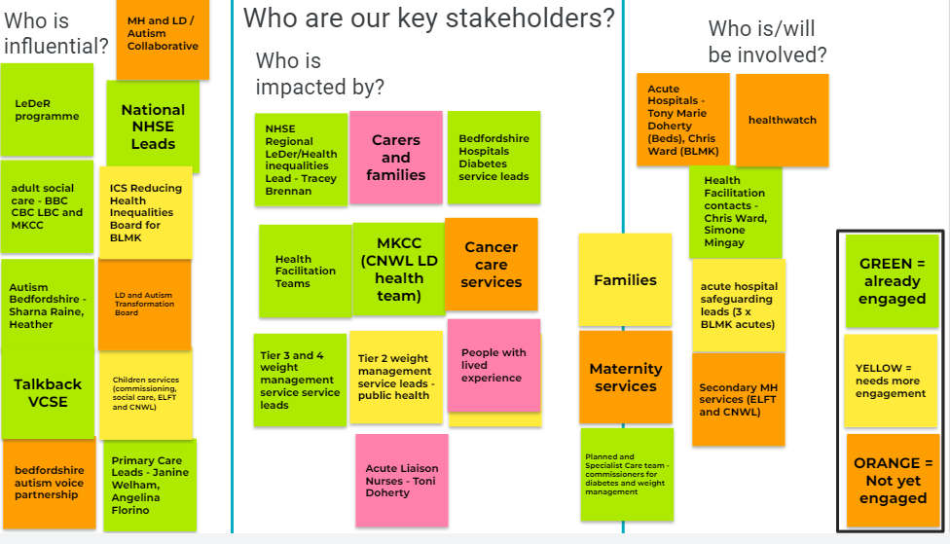
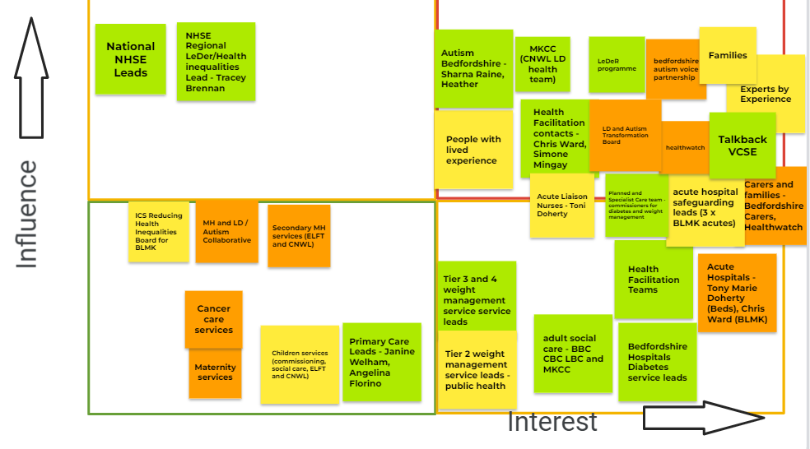
Mapping our stakeholders

Slide 24
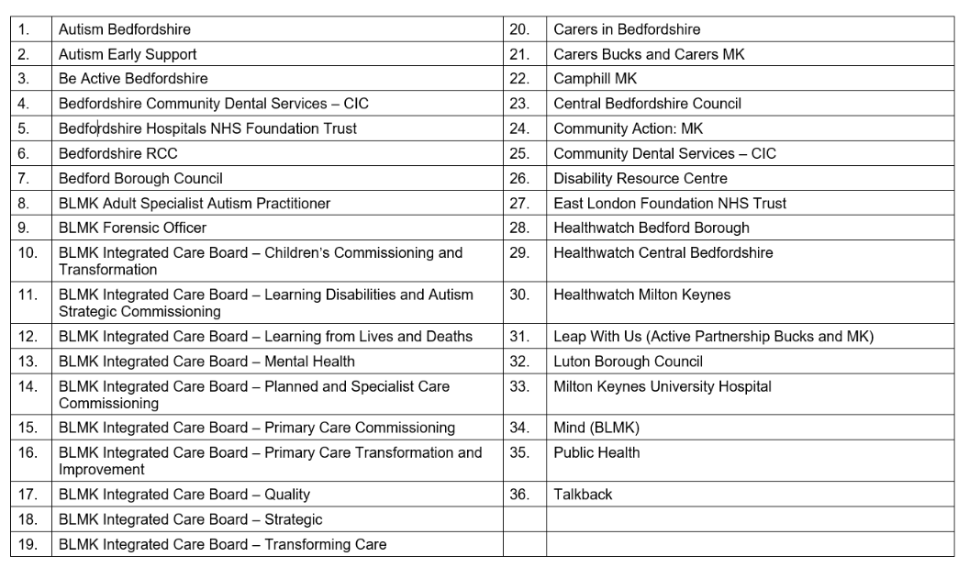
Engagement – Organisations that contributed to the development of this strategy
As we implement the ideas in this strategy, we will continue to engage with system partners across BLMK

Slide 25
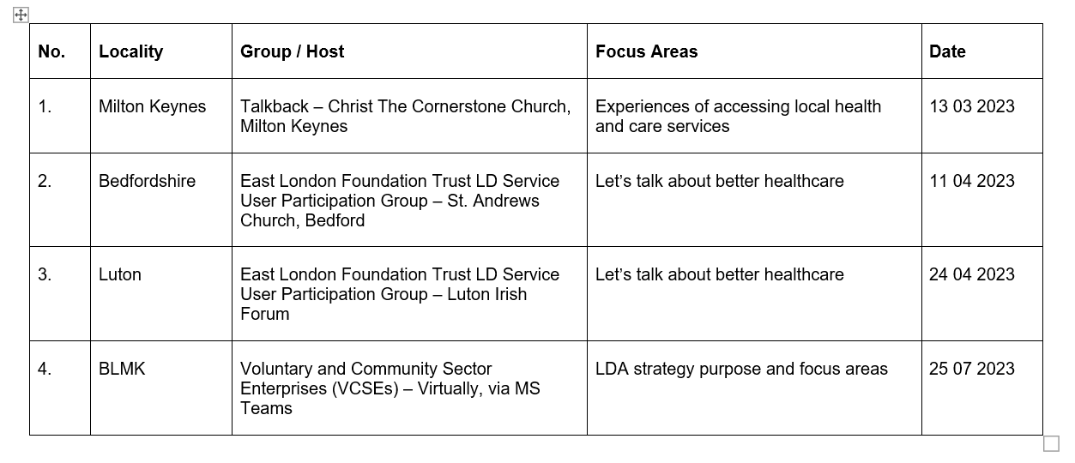
Engagement Workshops
Great interactive session
A well structured ICB workshop with knowledgeable professionals!
Thank you for listening

Slide 26
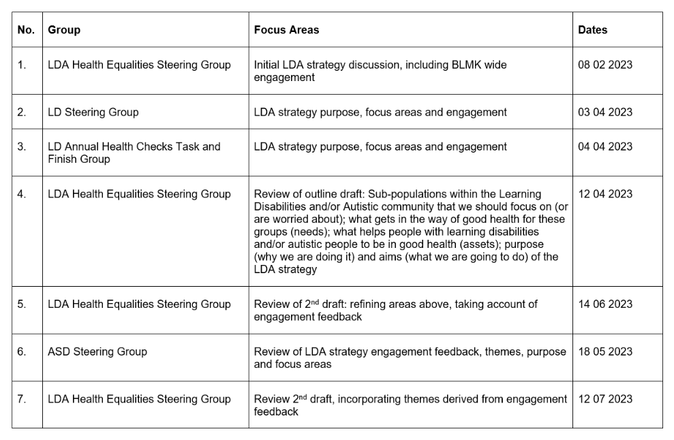
Engagement – BLMK Steering Groups

Slide 27
Step 4 – Develop a Purpose and Change Theory
What is the purpose of this work?
What is our theory about how we will improve things?
Driver Diagram & change ideas
1. Choose a population segment
2. Identify Assets and Needs
3. Create a Governance Structure
4. Develop a purpose and change theory
5. Develop a measurement plan
6. Start testing changes

Slide 28
Interdependencies
National strategy for autistic children, young people and adults: 2021 to 2026
NHS Long Term Plan, Learning Disabilities & Autism
Learning from Lives and Deaths programme (formally known as LeDeR)
Dynamic Support Register and Care (Education) and Treatment Review Policy and guidance, January 2023
Place Based Priorities (BBC, CBC, LBC & MKCC) covering Learning Disabilities & Autism
Special Educational Needs and Disability (SEND)
BLMK Reducing Health Inequalities Programme
BLMK Learning Disabilities Annual Health Checks
BLMK Section 117 Programme

Slide 29
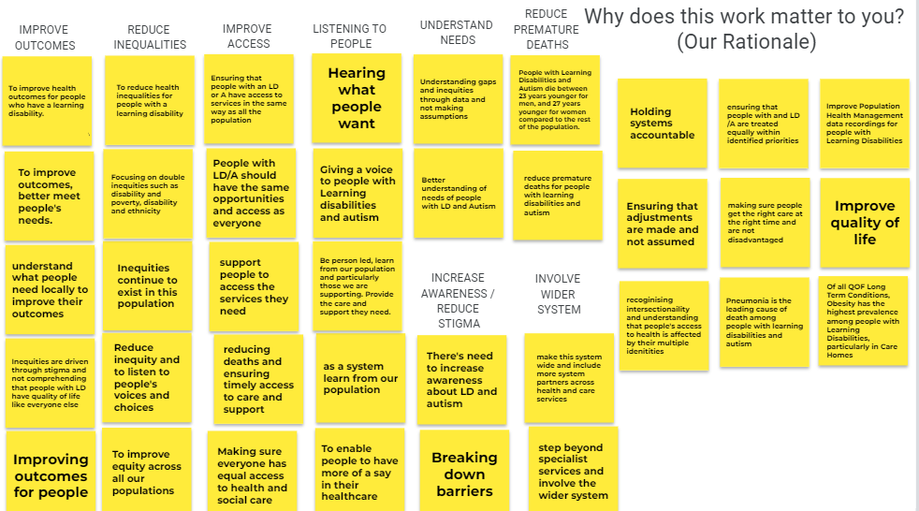
Our Purpose
“Mental and physical health matters to me.
If I feel healthy, I feel positive, I feel happy.”
We will work in partnership to reduce inequalities for people with Learning Disabilities and Autistic people by listening to people and increasing awareness of their needs. Our overall aim is to improve access, improve wellbeing outcomes and reduce premature deaths.

Slide 30
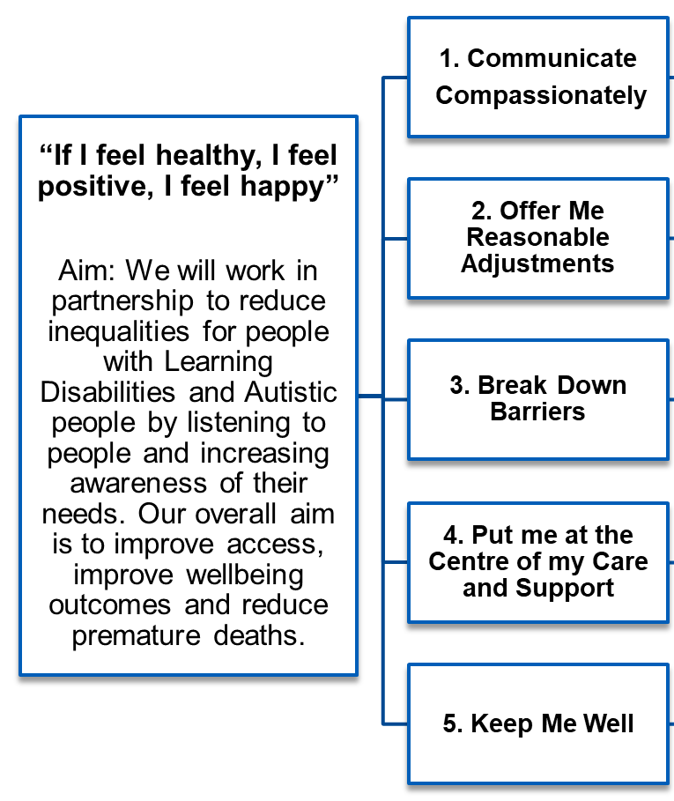
Our Strategy: 5 Asks
“Some reception staff have been rude. It’s very off putting and makes me not want to go back. You feel like you’re wasting people’s time. You can end up feeling pretty worthless”.
“The staff at my dentist always have a chat with me. They let me bring in a CD of relaxing music which is what I need”.
“I went to a breast cancer screening and took my support worker with me. I was nervous. I didn’t know what to expect. In the lead up to the appointment my mind was full of ‘what if’ scenarios. It was scary. It’s the ‘unknown’s’ you worry about”.
“Mental and physical health matters to me. If I feel healthy, I feel positive. I feel happy. If I wasn’t healthy, I wouldn’t be able to do what’s important which is to go to my social groups and my employability group. Without these groups I’d feel emotional, bored, and lonely”.
“Due to previous bad experiences of the dentist, I haven’t been since I was fifteen (now early thirties) I would only go to the dentist if it was absolutely necessary, but I’d have to be in pain to actually go”.

Slide 31
Our Strategy: What We are Going to Do
“If I feel healthy, I feel positive, I feel happy”
Aim: We will work in partnership to reduce inequalities for people with Learning Disabilities and Autistic people by listening to people and increasing awareness of their needs. Our overall aim is to improve access, improve wellbeing outcomes and reduce premature deaths.
1. Communicate
Compassionately
2. Offer Me Reasonable Adjustments
3. Break Down Barriers
4. Put me at the Centre of my Care and Support
5. Keep Me Well
Planned roll out of the Oliver McGowan Training for all health & care staff
Deliver Autism awareness training for Primary Care staff, Police & Probation service
Continue to work with people with a Learning Disability and Autistic people, and their families & carers, to deliver all areas of the strategy
Create sensory friendly environments both in the community and inpatient provision
Co-design accessible educational material for people with Type 2 Diabetes
Develop an autism pathway across BLMK
Co-design a series of orientation videos on what to expect when you access your health or care appointment
Continue to work with people with a Learning Disability and Autistic people, and their families & carers, to broaden our understanding of barriers to accessing services
Targeted work to increase AHCs for ethnic minority people & those who have not had an AHC in the last 2 years
Primary Care pilot to identify GP champions for people with a Learning Disability and Autistic people & share learning with practices requiring support
Develop a neurodiversity wellbeing model across BLMK, including pre and post diagnostic offer
Identify an initiative to increase the number of advanced care plans being delivered
Increase the number of Health Action Plans completed during the Annual Health Check
Develop a pilot project to centralise a BLMK TCP team & ensure compliance with the new guidance
Commission Autism practitioner roles to support people at risk of admission, project pilot in Bedford & MK
Develop a weight management initiative focused on prevention
Review the function & areas of responsibilities of the integrated LD nurses across Beds & LTN
Review forensic pathways across BLMK

Slide 32
Step 5 – Develop a Measurement Plan
How will we measure improvement?
What are our outcome, process and balancing measures?
What is our data collection plan?
1. Choose a population segment
2. Identify Assets and Needs
3. Create a Governance Structure
4. Develop a purpose and change theory
5. Develop a measurement plan
6. Start testing changes

Slide 33
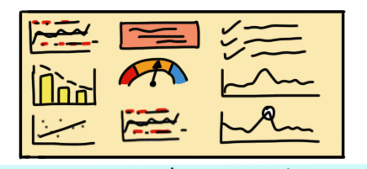
Measures in QI
Outcome Measures
  Tells us whether aim
  is being achieved.
Process Measures
  Attached to drivers or change ideas.
  How are the parts or steps in the system that you are trying to influence performing?
Balancing Measures
  What happened to the system as we improved the outcome?
  Any benefits/untoward consequences?
Notes:
There are three different types of measures – explain what's mentioned on the slides. Explain we’re going to look at an example in a moment.

Slide 34
Measurement Plan
Measure Type | Measure Name | Operational Definition | Data Collection Plan
Outcome | BLMK LeDeR reviews | 100% of all BLMK LeDeR reviews to be completed within 6 months from notification of death | Collected through the BLMK LeDeR programme that is reported into the BLMK TCP Board
Outcome | Premature deaths of people with learning disabilities & autistic people | Retrospective: Adopt the Markov Model to measure progressive diseases, and the cost effectivity of health care provided to a given population. | BLMK LeDeR programme annual report
Process | LD Annual Health Checks (AHC) ` | Increase the % of people with learning disabilities having received an AHC from 75% to 78% by 2024/25 | SystemOne reporting data that is reported into the BLMK LD AHC steering group and TCP board
Process | Emerging themes from the BLMK LeDeR report 2022 | Reduce the number of deaths reported in hospital from 78% to 76% by 2024/25 | BLMK LeDeR programme annual report
Outcome | Care & Treatment Reviews (CTR) | CTR to be offered to all people with learning disabilities and / or autism within 4 weeks of admission into a mental health inpatient provision where no community CTR took place | Assuring Transformation (AT) database
Outcome | Diabetes | Adults living with Type 2 diabetes who have a learning disability or autism to achieve better long-term health outcomes, in relation to their diabetes | Engagement and co-production through the 'BLMK Equalities Link Worker' pilot project

Slide 35
Measurement Plan continued ...
Measure Type | Measure Name | Operational Definition | Data Collection Plan
Process | Learning Disability registers | Increase the number of people reported on the learning disability register with known severity of learning disability stratification (mild, moderate, severe, profound) | SystemOne data, reported into the LD AHC steering group and BLMK TCP board
Outcome | Improved communication – Weight Management Services | Supporting patients with a learning disability and family / carers to feel better informed of their journey through Tier 3 and 4 weight management services in BLMK | Ongoing engagement and co-production through the 'BLMK Equalities Link Worker' pilot project 2023/24 - 2024/25
Process | Tier 3 Weight Management Service | Reduce the DNA rate by 5% for people with a learning disability and autistic people living with obesity who are due to attend Tier 3 weight management appointments in BLMK by 2024/25 | Tier 3 weight management service. Link in with the lead commissioner to ascertain how this can be captured
Process | Advanced Care Plans – LeDeR | Increase the proportion of people with a learning disability and autistic people who have an advanced care plan in place from 22% to 25% by 2024/25 | BLMK LeDeR programme annual report, check with the Bedfordshire and Milton Keynes Hospital Trusts
Balancing | CTR post discharge | CTR to be offered to all people with learning disabilities and autistic people within 6 weeks of discharge from a mental health inpatient provision | Assuring Transformation (AT) database

Slide 36
Measurement Plan continued ...
Measure Type | Measure Name | Operational Definition | Data Collection Plan
Process | Oliver McGowan training | 10% of the health and care workforce across BLMK to have completed the Oliver McGowan training by March 2024 | Workforce lead for BLMK
Process | Cancer screening | Increase breast screening for people with learning disabilities of eligible age by 5% in 2024/25 | SystemOne data
Balancing | Health Action Plans (HAP) | Increase the total number of people receiving an LDAHC on LD Register aged 14+ that received a HAP between April 2023 - March 2024 from 85% to 87% by 2024/25 | SystemOne data reported into the Learning Disabilities Annual Health Check steering group and BLMK TCP board
Process | Learning disability register protected characteristics | Increase the number of people on the learning disability register with known Equality Act 2010 protected characteristics (for example ethnicity, disability, sexual orientation) | SystemOne data reported into the Learning Disabilities Annual Health Check steering group and BLMK TCP board

Slide 37
Appendix: Language
Autism can mean many things to many people. There are several terms that different people and groups prefer to use, including; autistic spectrum disorder, autistic spectrum condition, autistic spectrum difference, has autism, is autistic and neurodiversity.
We have a person centered approach to communicating with individuals and will ask and follow your preferences. Autism Bedfordshire use ‘autistic’ in their published communications and materials as an umbrella term for all such terms, including Asperger’s syndrome. This is in line with the terminology adopted by the National Autistic Society.
The National Autistic Society: What words do people prefer to use to describe people on the autism spectrum? ‘Autistic’?, ‘with autism’?, ‘has autism’? The language used is important because it embodies and can therefore help change attitudes towards autism.
A piece of research published in the Autism journal in 2015 looked at the preferences of people on the autism spectrum, their families, friends and professionals around the language used to describe autism. The research was conducted by The National Autistic Society (NAS), the Royal College of GPs and the UCL Institute of Education. The findings confirmed that there is no single term that everyone prefers. However, they suggest a shift towards more positive and assertive language, particularly among autistic communities where autism is seen as integral to the person.
Survey responses from 3,470 people were analysed, including 502 autistic adults, 2,207 parents of children and adults on the autism spectrum, 1,109 professionals, and 380 extended family members and friends. The research found that all groups like the terms ‘on the autism spectrum’ and ‘Asperger syndrome’. Autistic adults like the identity-first terms ‘autistic’ and ‘Aspie’, whereas families didn’t like ‘Aspie’. Professionals also like the term ‘autism spectrum disorder (ASD)’. Some terms were strongly disliked or no longer used, particularly ‘low functioning’, ‘Kanner’s autism’ and ‘classic autism’. The language used is important because it embodies and can therefore help change attitudes towards autism. To reflect the findings of this research, the NAS has begun to gradually increase the use of the term ‘autistic’ – particularly when talking about and to adults in that group. Another term used ‘on the autism spectrum’ as the default way of describing people on the autism spectrum.
The research shows that language preferences are evolving, and research continues to test how different groups prefer to speak about autism. The debate around the way we describe autism in the public domain is different to the terms used to diagnose autism by medical professionals. Find out more about diagnostic terms and criteria.
For our resources, we have chosen to use identity-first language throughout.

