Slide 1
The Children and Young People’s Mental Health Local Transformation Plan (LTP)
2021/22
Notes:
JM

Slide 2
What do children and young people tell us about our plans?
“As an integrated board and as individual organisations within that board we are fully committed to improving our approach to ‘people participation’ and it is an agreed priority for the coming years.”
Our young service users kindly gave their views on our Local Transformation Plan [next slide] and continue to work with us on a creating a short film to highlight what mental health transformation means to them.

Slide 4
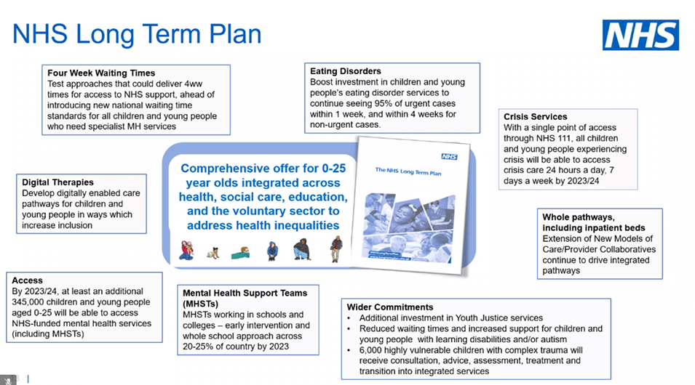
Local Transformation Plan
NHS England requires Systems (BLMK CCG) to publish their LTP and report against some key areas known as ‘key lines of enquires’. We published BLMK LTP 2019 – 2021 which can be found on our websites. Our LTP refresh for 2021/22 seeks to share progress against our BLMK ambitions for children’s mental health, and delivery of the NHS Long Term Plan.
NHS ‘10 year Long’ Term Plan 2019

Slide 5
Structure of our report
:
How we support our children’s mental health; The I-Thrive model
The impact of Covid on our children
Key Lines of Enquiry
  Transparency and Governance
  Understanding our local need and addressing health inequality
  Local Transformation Plan
  Workforce
  Health and Justice
  Eating Disorders
  Data – Access and Outcomes
  Urgent and emergency mental health services
  Early intervention in Psychosis
  Mental health services and educational settings
  Digitally enabled care pathways
Summary

Slide 6
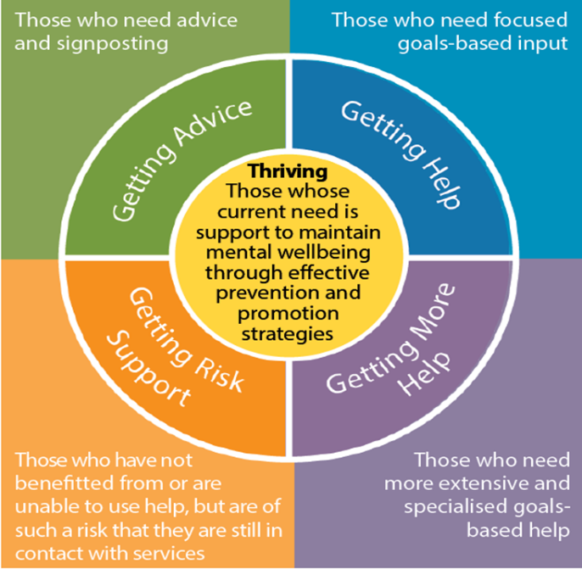
How we support our children with their emotional wellbeing and mental health in BLMK
Ithrive model
We provide a range of support for our children based upon the IThrive principles to ensure access to the right support at the right time, and work with our partners to deliver a whole system approach from prevention, to early intervention, to specialist treatment if needed for our children.
Notes:
This is how we look at MH
Holistic offer for C&YP

Slide 7
Early headlines of the impact of Covid on our children
Effects from the Covid Pandemic on children are still an emerging picture.
We know that our children have been uniquely impacted by the pandemic and lockdown, with NHS research suggesting 1 in 6 may now have a mental health problem, up from 1 in 9.
Our specialist Mental Health Providers and partners organisations have made us are aware of the following effects:
Impact on school attendance.
Disproportionate effect for vulnerable families and increased inequalities for children and young people.
Dramatic surge in mental health and wellbeing concerns especially for children with other conditions and vulnerabilities.
A particular spike in eating disorders
An increase in the numbers of children and young people who have needed intensive mental health care.

Slide 8
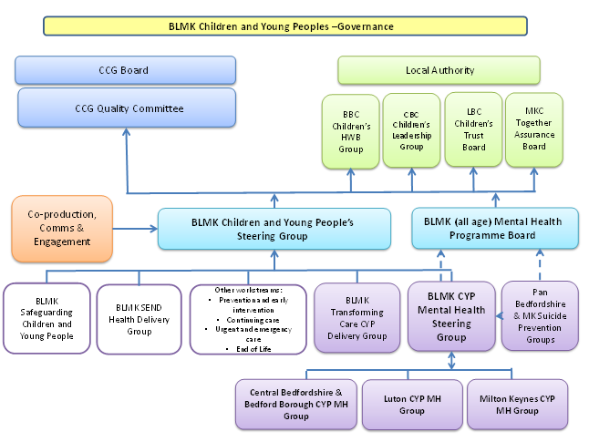
Transparency and Governance
We continue to be committed to transparency and robust governance as we develop into an Integrated Care System (ICS).
We will have further strategic oversight and governance from our new ICS Children Transformation Board

Slide 9
Understanding our local needs and addressing inequalities.
We have a good understanding of children’s emotional and wellbeing needs that provides a platform on which to develop our focus for the transformation:
System partnerships – working together with our 4 Local Authorities and voluntary and community sector to support a child’s emotional and wellbeing together.
Voice of the child – children and young people who have used our emotional and wellbeing and mental health services share their experiences to inform service transformation
Co-production groups – listening to families, carers experiences to inform needs
Joint Strategic Needs Assessments - Place based needs assessments include – mental health, Special Educational Needs and Disabilities and impact of Covid
Monitoring the demographics of children referred and accepted into specialist mental health services to inform ongoing needs, and improving data collection of our most vulnerable children
We have developed a new Integrated Care System BLMK Advancing Mental Health Equalities group focusing on delivering mental health priorities for our children including access to help, experience and outcomes.

Slide 10
Local Transformation Plan ambitions
We continue to strive for continuous improvement in our services for children and young people’s mental health and emotional wellbeing by:
Increasing our early intervention & preventing by strengthening our community offer – including increase support for Primary Care, launch of our Discovery College and delivering and evaluation a social prescribing pilot
Increasing our Mental Health Support for Schools teams
Expanding support for young people with Eating Disorders
Developing a single crisis service for all children with the development of an integrated inpatient services & intense home treatment teams
Developing our Intensive Support Team to support a young person with a learning disability or who are on the autistic spectrum.
Improved system work for our very complex children - launching a new integrated and personalised pathway to a child who has been admitted into hospital
Ensuring positive practices & learning from COVID are embedded – develop our digital offer
Co-production is embedded within everything we do
Integration with system partners to develop resilience within local communities

Slide 11
Workforce
Workforce development is central to the delivery of our mental health transformation in BLMK.
Effectively working with the community and voluntary sector and to support the development of our volunteer workforce.
Providing virtual career events in Mental Health to engage and attract future workforce
Collaboratively working to upskill wider health colleagues to support mental health needs, developing skill mix and new workforce roles for example our new emotional wellbeing practitioner training programme.
Providing a BLMK Keeping Well support Hub to support staff wellbeing and retention
Considering different modes of service delivery technological for maximising workforce productivity by working closer with Bedfordshire University
Regularly collecting and reporting workforce information to understanding our local challenges
Developing expert by experience roles.
We have a BLMK Mental Health workforce strategy and action plan that is driving forward how we are going to deliver our mental health workforce ambitions

Slide 12
Health and Justice
Young People in contact with the justice system are some of our most vulnerable young people. Across BLMK we have:
Mental health services that specifically link with our Youth Offending Teams (YOT) to ensure that there is quick and early access to care.
Street triage and court liaison and diversion and are supporting equity of access to age appropriate services across BLMK.
We provide targeted speech language therapy provision. We are planning to increase this offer within our youth offending services
There is quick access to school nurses to support the health needs of a young person
Specialist forensic CAMHS service from NHS England to support the care pathway for a young person.
Ongoing needs assessments to ensure we are meeting the emotional and wellbeing needs of our young people
Behavioural Improvement Team – targeted school input to our Pupil Referral Units for those most at risk to reduce behaviours
We continue to be a strategic partner at all our Local Authority place based youth offending boards to ensure that we are meeting these children’s health needs.

Slide 13
Eating Disorders
Following the Pandemic we have seen our Children’s Eating Disorders teams referral activity increase, with young people presenting with higher needs and some of these children having to access acute paediatric services across BLMK.
Our additional investment into the Children and Young People’s Eating Disorder pathway will ensure young people and their families are provided a range of therapeutic interventions. We will be:
Expanding our Community Eating Disorder Services to meet increasing demand, including Avoidant Restrictive Food Disorders ( ARFID) pathways
Expanding our Children Eating Disorders day programme to provide a daily community based service to young people at risk of requiring admission. This will be a combination of clinic, home and virtual treatment.
A system wide Clinical Reference Group is supporting this work and developing BLMK guidelines for the physical health management of eating disorders in children and referral processes
We will expand our services to support children with eating disorders

Slide 14
Data, Access & Outcomes
Across Bedfordshire, Luton and Milton Keynes, improving quality of mental health data with our providers and being compliant with data flow to the Mental Health Services Data Set (MHSDS) is a priority for us.
Our services continue to make good progress with our meaningful Routine Outcome Measures reporting and continue to receive positive feedback from young people and their families.
Routine Outcome Measures are being recorded directly onto our Providers clinical systems, increased efficiency and quality as previously two separate systems.
Routine Outcome Measures are co-produced and offered at the appropriate stage in treatment
Our referral discharge process ensures as many referrals as possible have paired meaningful outcome measures prior to discharge to ensure we are providing not only a timely service but quality service supported by national evidence based outcome measures.

Slide 15
Urgent & Emergency (Crisis)
Mental Health Care for children
Transformation investment will provide a comprehensive, integrated Crisis offer that makes best use of systems resources and delivers evidence based models of care for crisis and home treatment this year:
Children and young people to remain in safe and supported homes
Avoid unnecessary admission to hospital wherever possible
When admission to hospital is needed, care is provided as close to home as possible and for an optimal period of time.
Our Extended Home Treatment Team operating hours will proactively work with our community services to avoid admission and to facilitate early discharge:
Single point of access including through 111 to crisis support, advice and triage
Will enable the crisis pathway across BLMK to continue providing 7 days working to allow young people presenting in crisis to receive a rapid same day assessment.
Our Intensive Home Treatment service will include support for our young people with Eating Disorders and Autism and/or Learning Disabilities.
Offering a single crisis pathway with agreed key principles regardless of clinical need
We will have a single crisis service for our children

Slide 16
Early Intervention in Psychosis
The Early Intervention in Psychosis Services for Bedfordshire, Luton and for Milton Keynes continue to meet the access standard of a maximum wait of two weeks from referral to start of treatment, and provide a service for young people from age 14 . The Bedfordshire and Luton Service also has a provision for people with an At Risk Mental State (ARMS).
Early Intervention in Psychosis services and CAMHS work together to provide care for all young people under the age of 18 have joint care planning joint policy.
The service offer includes;
  Family therapy
  Work placed / education support
  Cogitative Behavioural Therapy for psychosis
  Range of interventions and with outcome metrics
We will develop our ARMS offer for all our children

Slide 17
Mental Health Services working with education settings
BLMK have four mental health school teams and will mobilise a further seven teams over the next two years. We are currently mobilising three of these teams this academic year.
Mental Health Support Teams will target areas of greatest need across BLMK.
The Mental Health Support Teams are provided by ELFT and CNWL who already provide the CAMH services and so there is integration between these services as well as there being smooth care pathways in place so that access to advice and support from CAMHS can happen as quickly as possible as well as access to urgent and emergency care.
We are working with our Partners to build a comprehensive directory of all prevention and early intervention offers to support a young person’s emotional wellbeing.
Provide an integrated whole schools approach with input from Community Voluntary Sectors, 0-19 health and school nursing teams, Early Help and education

Slide 18
Digitally enabled Care Pathways
We are establishing new ways of providing services for our children, building on the rapid mobilisation of our digital care pathway as a result of the Pandemic.
Working with our young people as experts we are reviewing digital opportunities with:
Reviewing our current digital offer ‘Kooth’
enabling self referrals in every part of the System
developing Self help / guided self help
developing a phone App for supporting young people with Eating Disorders
support young people who are waiting
what funding routes are available to develop our digital offer
We have brought together a task and finish group that has initially scoped digital options to consider expanding and new digital pathways of care.

